Slide 1
Stock Market Data Streaming
Shail Patel (CWID: 885175489)
Malay Koladiya (CWID:885867812)
CPSC - 531 - Adv Database Management
Github link: https://github.com/shail2811/stock_market_data_streaming

Slide 2

Project Definition
“Stock Market Data Streaming using Kafka, Databricks & AWS.”

Slide 3
Problem Statement
A stock market data streaming platform is required to provide real-time streaming of stock market data for analysis and decision-making purposes. Now a days it is hard to find a good trading system due to which high volume of data is not getting on real time due to which the trader has to bare the huge losses from stock market. To resolve this issue we are planning to stream data real time which can be access online so we are planning to implement this using aws cloud to and various big data tools and technology.
By solving this issue we can make our decision very quick with the help of buy and sell signal generated in real time. So, we are configuring the system to handle high volumes of data in real-time from various sources, including stock exchanges, financial institutions, and news agencies. The data should be processed and analyzed in real-time using machine learning algorithms to provide insights and actionable intelligence to traders and investors.

Slide 4
Project Description
This project aims to build a real-time stock market data streaming application using Databricks, Kafka, Zookeeper, and AWS EC2 instances. The application reads a CSV file containing stock market data and uses Databricks to analyze the data. The sample rows from the CSV file are extracted and sent to a Kafka producer, which then streams the data to a Kafka consumer. The consumer then performs real-time data analysis to provide insights into stock market trends. The challenge is to ensure that the data is processed and analyzed in real time and that the system can handle large volumes of data efficiently and effectively.

Slide 5
Technologies and Tools
Python and PySpark Programming
Amazon Web Services
Kafka and Zookeeper Servers
DataBricks Notebooks

Slide 6
Databricks
Databricks is a cloud-based data analytics platform that provides a unified approach to data processing and analytics. It is designed to handle large-scale data processing and analytics using Apache Spark, a powerful open-source distributed computing framework.
In context to Stock Market OLTP application, Databricks can be used for:
Data Processing
Data Analysis
Features of Databricks….
Scalability
Cloud Based
Speed
Real Time Processing

Slide 7
Kafka & Zookeeper
Kafka is a distributed streaming platform that is widely used for building real-time data pipelines and streaming applications. There are several reasons why Kafka may be a good choice for a stock market OLTP application.
Real-time analytics, scalable, Integration with other systems, Data ingestion
ZooKeeper is a distributed coordination service that is often used in distributed systems for managing configuration information, synchronization, and providing group services. In the context of a stock market OLTP application, ZooKeeper can be used for various purposes such as:
Configuration management, Synchronization, Failure detection and recovery

Slide 8
Approach
Setting up EC2 instance on AWS
Install and Configure Kafka and Zookeeper
Create, Configure and Test Kafka Producer and Consumer notebooks in Databricks
Refine the application
Deploy the application

Slide 9
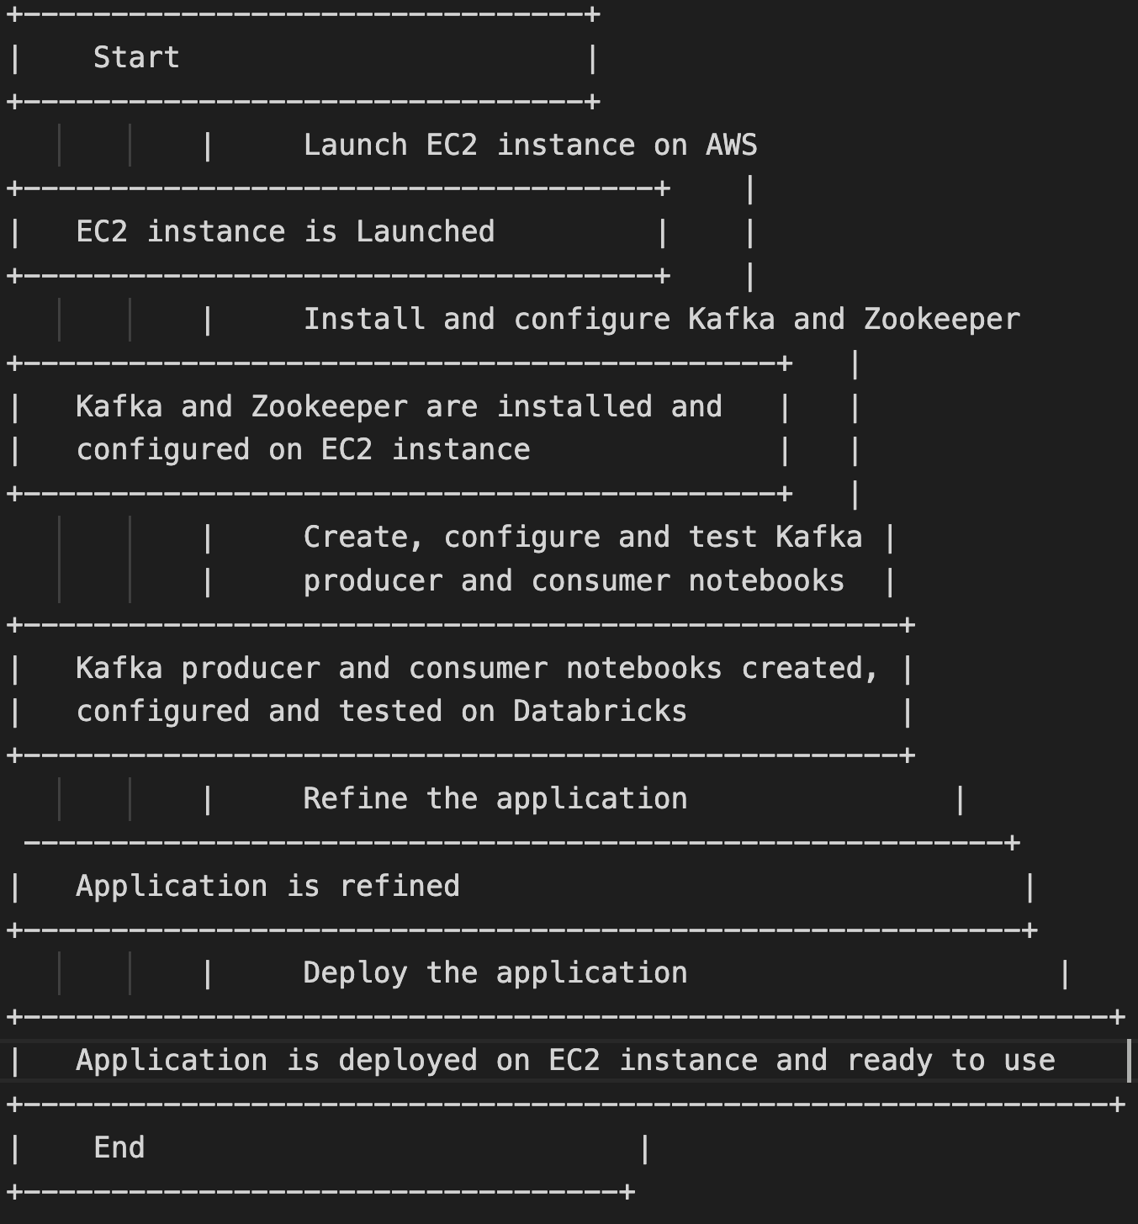
Flowchart

Slide 10
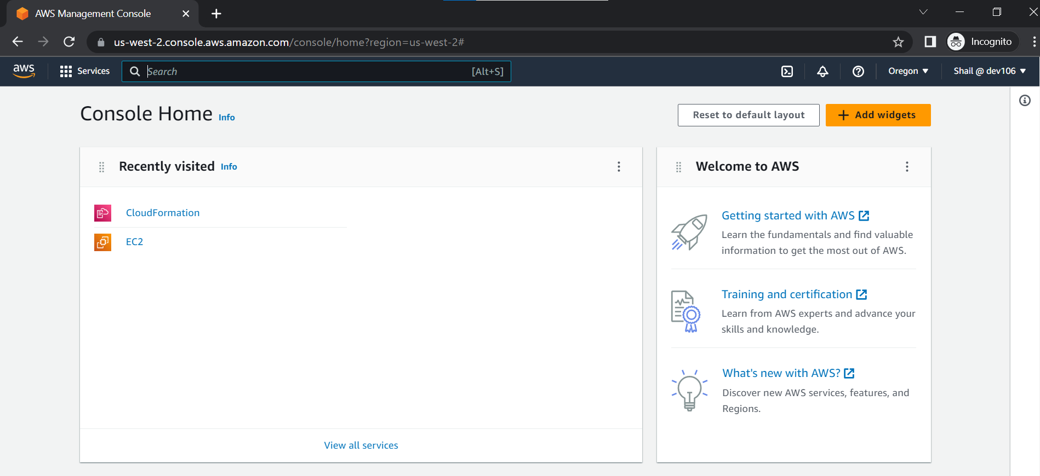
Setting EC2 instance on AWS and Kafka
https://dev106.signin.aws.amazon.com/console
Go to the above link and log in with the given credentials and then click on EC2

Slide 11
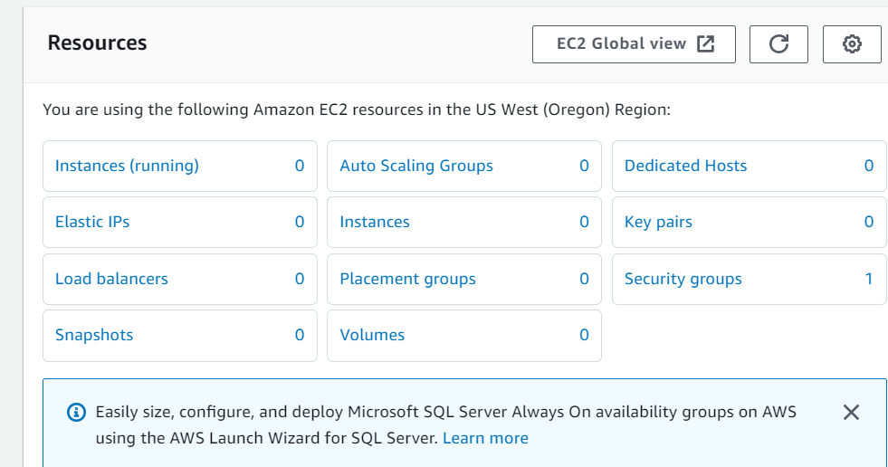
Click on Instances

Slide 12
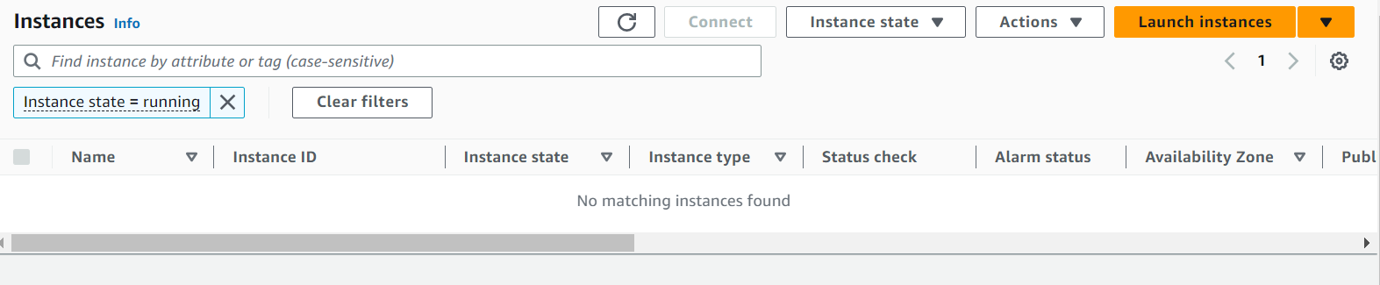
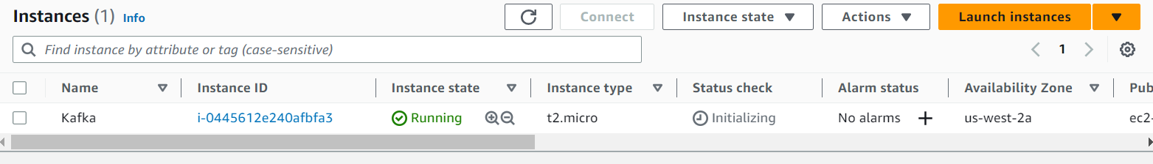
Click on launch instance AND Give a name to your instance, create a keypair and keep the rest of the configurations to default and click on launch instance.

Slide 13
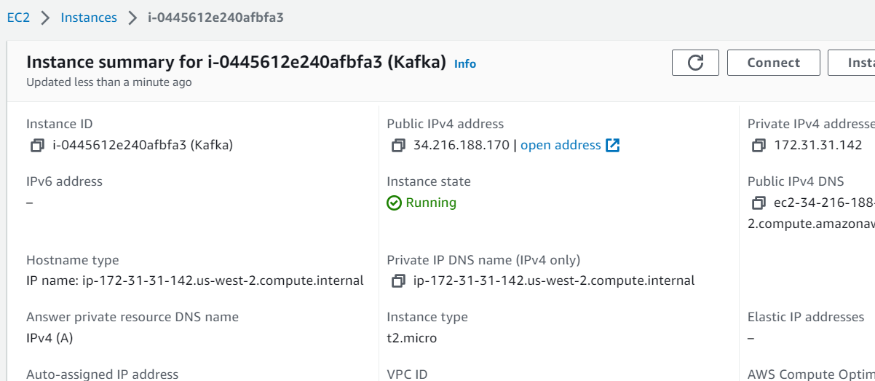
Click on the instance id and Click on connect

Slide 14
We will run the following commands on our instance to setup kafka and zookeeper
We get https://archive.apache.org/dist/kafka/3.3.1/kafka_2.12-3.3.1.tgz
tar -xvf kafka_2.12-3.3.1.tgz
-----------------------------------------------------------------------
java -version
sudo yum install java-1.8.0-openjdk
java -version
cd kafka_2.12-3.3.1
sudo apt-get update
sudo apt-get install -y openjdk-8-jdk
java -version
cd kafka_2.12-3.3.1
-------------------------------------------------------------------------------------------
Start Zookeeper:
bin/zookeeper-server-start.sh config/zookeeper.properties

Slide 15
Start Kafka-server:
Duplicate the session & enter in a new console --
export KAFKA_HEAP_OPTS="-Xmx256M -Xms128M"
cd kafka_2.12-3.3.1
bin/kafka-server-start.sh config/server.properties
It is pointing to private server , change server.properties so that it can run in public IP to do this , we can follow any of the 2 approaches shared below
Do a "sudo nano config/server.properties" - change ADVERTISED_LISTENERS to public ip of the EC2 instance
--------------------------------------------------------------------------------------------------------------
Create the topic:
Duplicate the session & enter in a new console --
cd kafka_2.12-3.3.1
bin/kafka-topics.sh --create --topic demo_testing2 --bootstrap-server 54.215.179.39:9092 --replication-factor 1 --partitions 1

Slide 16
Start Producer:
bin/kafka-console-producer.sh --topic demo_testing2 --bootstrap-server 54.215.179.39:9092
----------------------------------------------------------------------------------------------------------------
Start Consumer:
Duplicate the session & enter in a new console --
cd kafka_2.12-3.3.1
bin/kafka-console-consumer.sh --topic demo_testing2 --bootstrap-server 54.215.179.39:9092
--------------------------------------------------------------------------------------------------------------
In Databricks create a cluster and install this library on the cluster kafka-python and
Attach the cluster to both the notebooks, change the IP to the current instance IP and run the notebook.

Slide 17
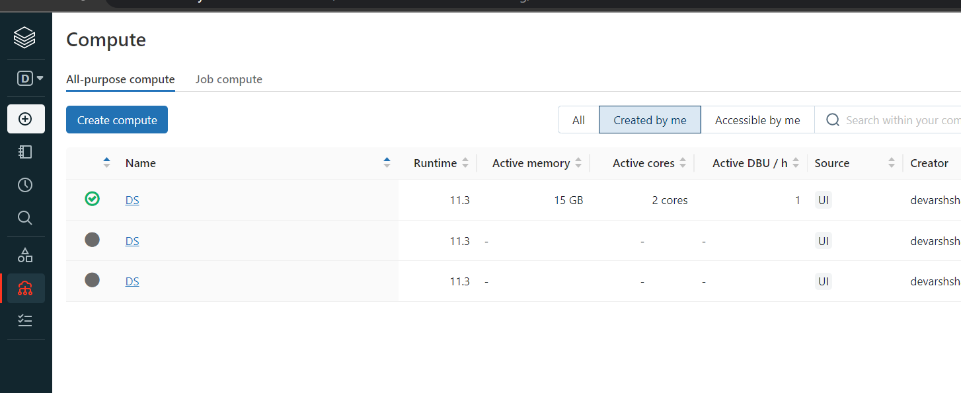
After the kafka cluster is setup on the instance, we will go to our Databricks notebooks and setup kafka consumer and kafka producer
Go to compute and click on create compute to set up a cluster

Slide 18
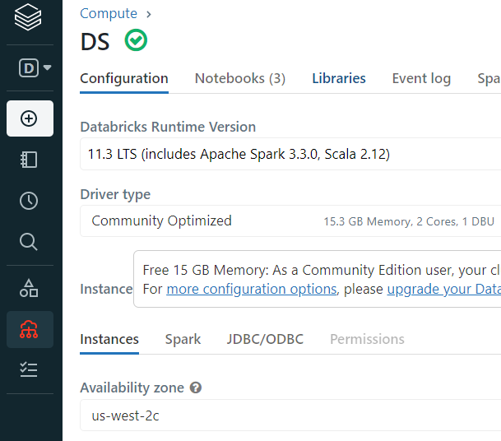
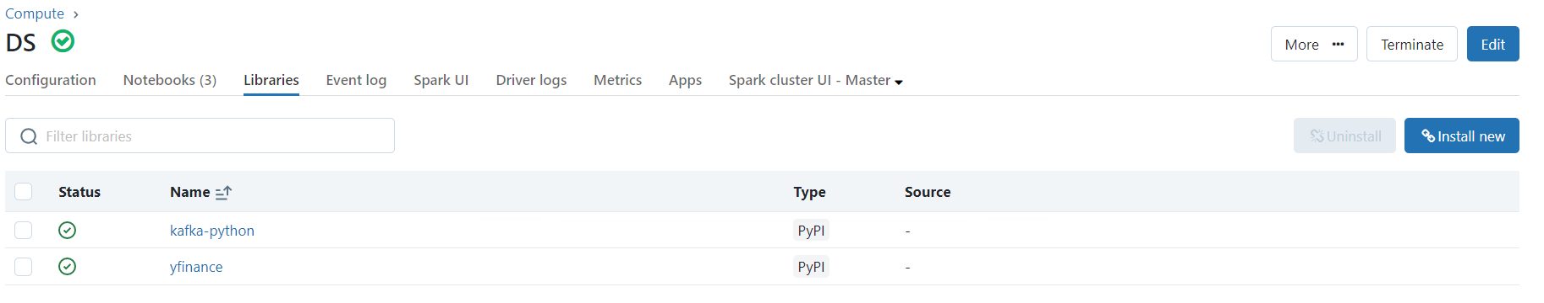
Click on the cluster name and go to libraries and install 2 libraries yfinance and kafka-python

Slide 19
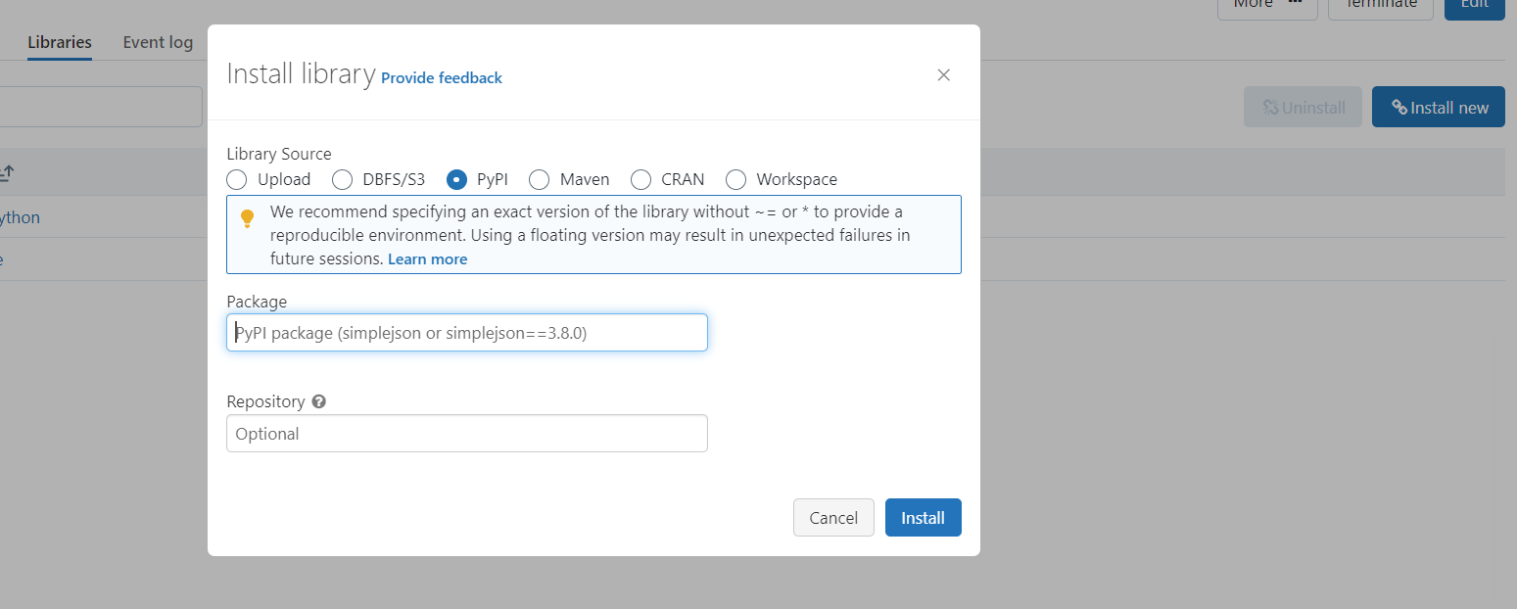
Select pypi and install two libraries one by one, kafka-python and yfinance

Slide 20
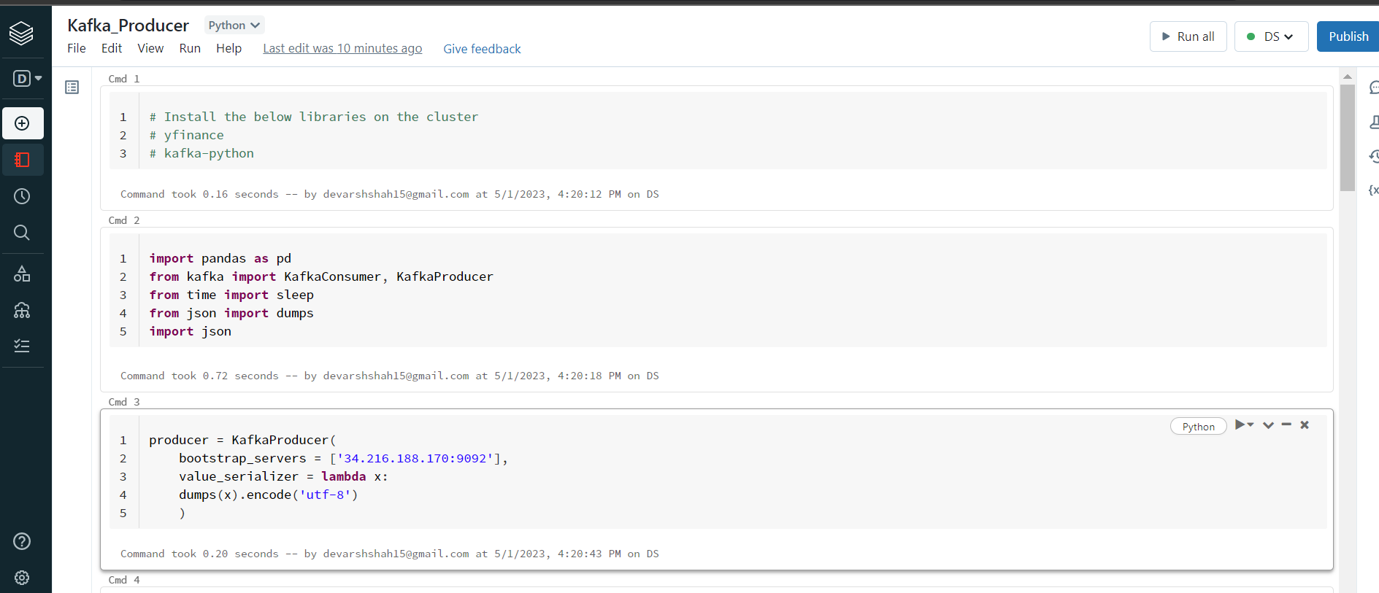
Go to kafka producer notebook and click on run all

Slide 21
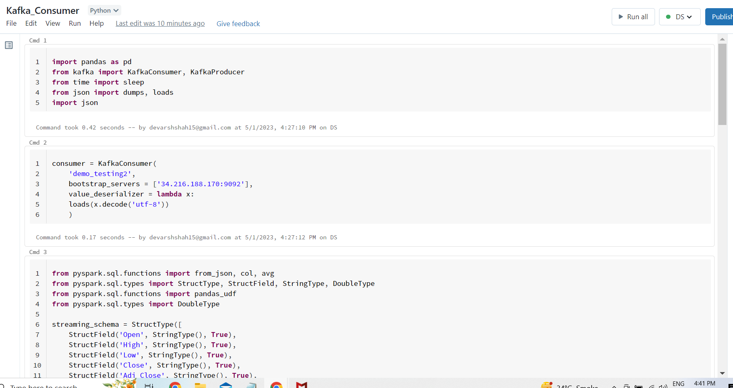
Go to kafka consumer notebook and click run all

Slide 22
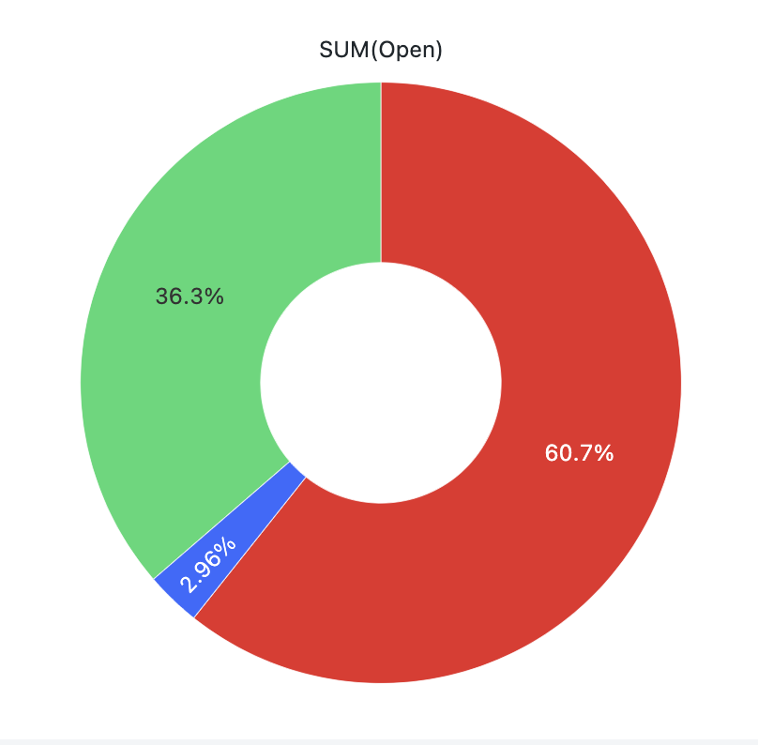
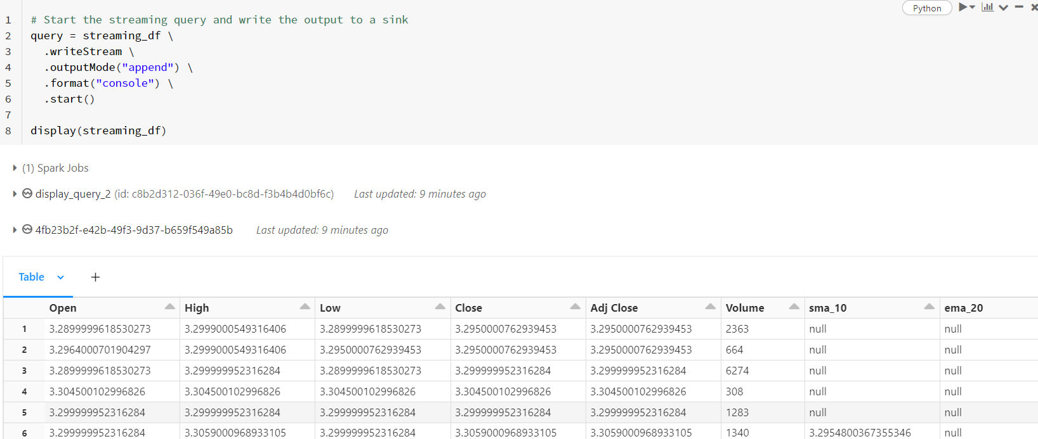
You will start seeing the values in the stream

Slide 23
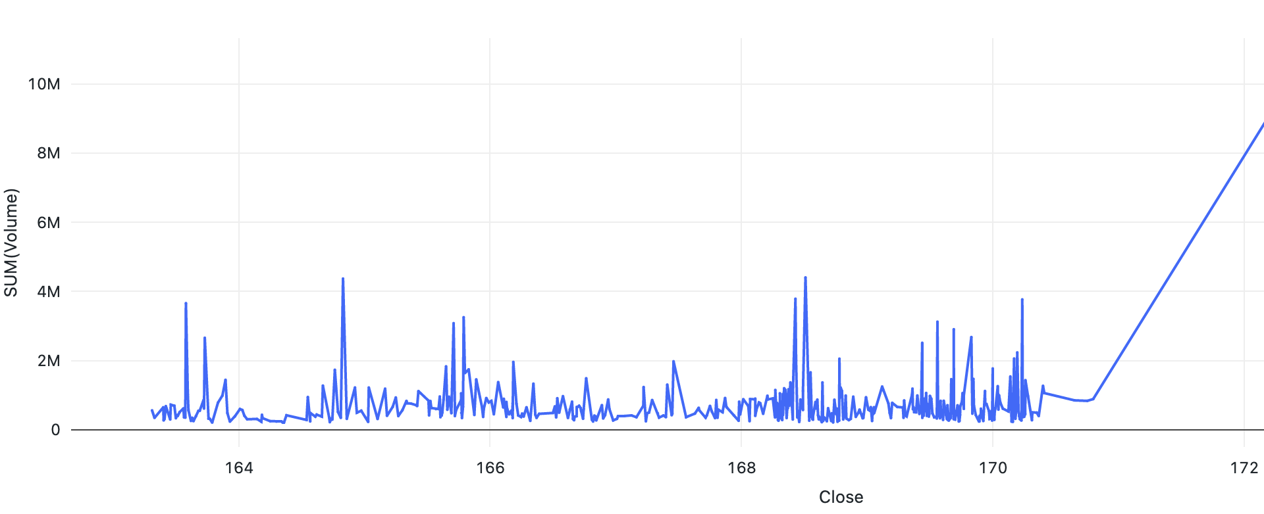
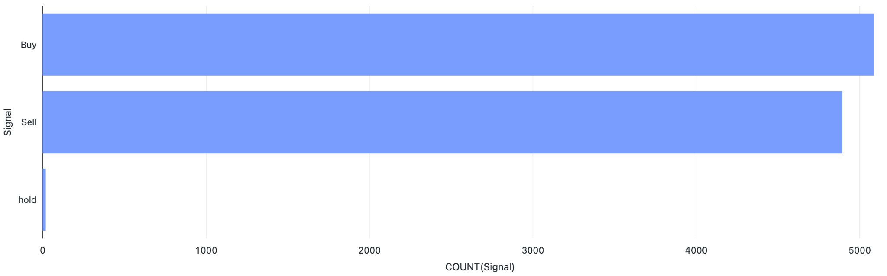
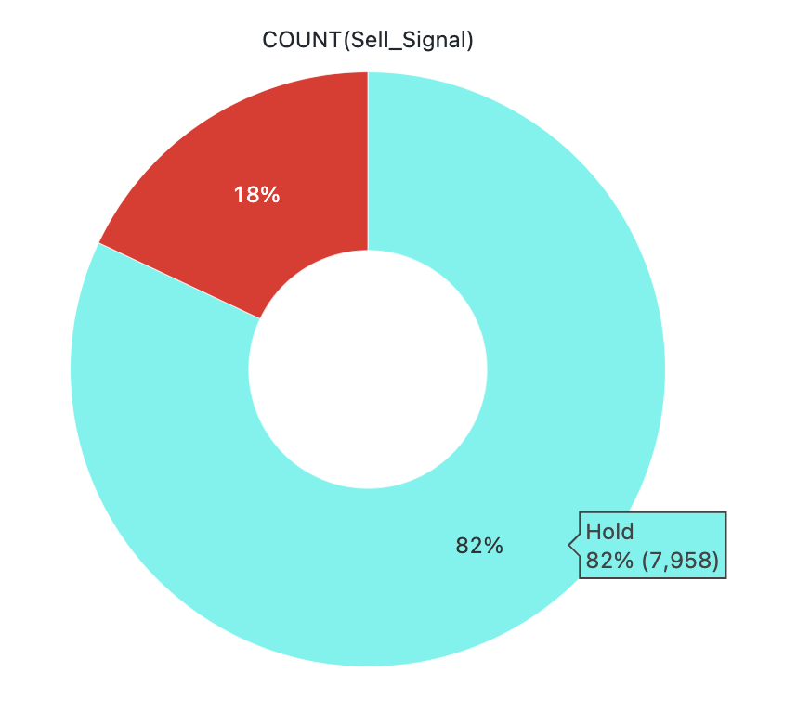
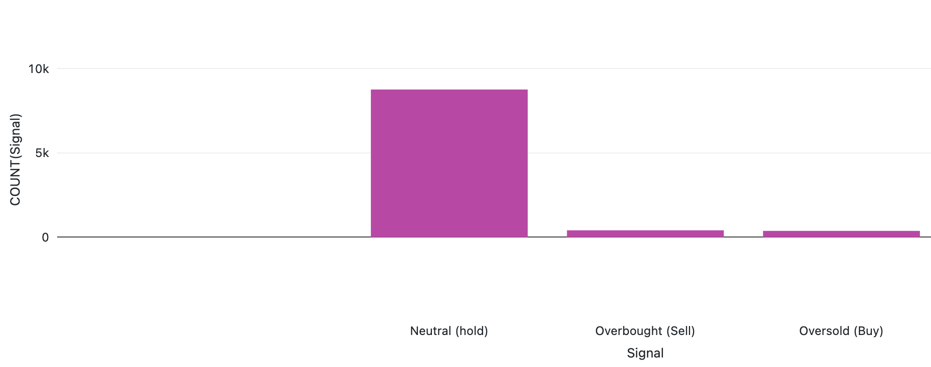

Slide 24
Thank You

